Slide 1
RockNRome Style Guidelines
RockNRome Style Guidelines
These guidelines outline the style, colors, fonts and other visual elements for the RockNRome style used on a Rock N Rome website.
Table of contents
Logo and logo use
Colors
Typography
Buttons
Iconography
Resources

Slide 2

Colors
The color scheme used for the website is Monochromatic scheme with the following colors in it:
The Background color for the website is WHITE with the RGB code #FFFFFF.

Slide 3
Buttons
The color for buttons on the site is BUTTON BLUE RNR with the RGB code #4CB5F7 and the sample below:
The shape of a button is rectangular with rounded corners. There is no restrictions on the width and height of a button design. It has to be properly aligned and visually in harmony with the rest of the website design.
The color for the button interactive functions should be in accordance with the color scheme used for the rest of the website.
An example of a button is below:
Button

Slide 4
Typography
The font family used for the website is Source Sans Pro with the weight of 400 and the following sizes in accordance with the font tags:
Tag | Type | Size | Color
h1 | header1 | 16
h2 | header 2 | 40
p | paragraph | 30
Below are the samples of the font usage with their type, sizes and colors:
Header 1 (Heading) font bold
Header 2 (Subheading) font plain
Paragraph font plain

Slide 5
Typography
The following types and style of the font are the only ones allowed to use on the website.
Header 1 only used in Bold, for main heading, while Header 2 is used for Subheading in plain.
The Paragraph is only used in plain style for paragraph text.
The positioning of the Header 1 is in the Center.
The positioning of the Subheading in in the top left.
The paragraph is positioned to the left below the Subheading with the justification on the width.
Note1 : there is no circumstances when UPPERCASE phrasing allowed to be used on the website.
Note 2: there is no circumstances when double spacing is allowed to be used on the website.
Note 3: the only structure fir the text that is allowed on the website is as follows:
Main Header, then Subheading, then Paragraph.

Slide 6
Lists
The lists on the site are using Subheading as a title and the Paragraph as the font for items on the list, as shown on the example below:
List example
Item 1
Item 2
Item 3
The lists on the site are using Subheading as a title and the Paragraph as the font for items on the list, as shown on the example below:

Slide 7
Spacing
The spacing between the paragraph lines set for the website is 1.15 pts.
The spacing between the Subheading and the Paragraph is 2.3 pts.
The spacing between the Main Header and Subheading is 2.3 pts.
The spacing between Paragraphs is 2.3 pts.

Slide 8
Spacing
Main Header
Subheading
Paragraph
Paragraph
2.3 pts
2.3 pts
1.15 pts

Slide 9
Icons
The icons used for the website are in Outlined style using the color scheme of the website and visually harmonical with the rest of the website design.
The sample of the icons is below.
Note: the below icons are not in the website color, only for style reference.

Slide 10
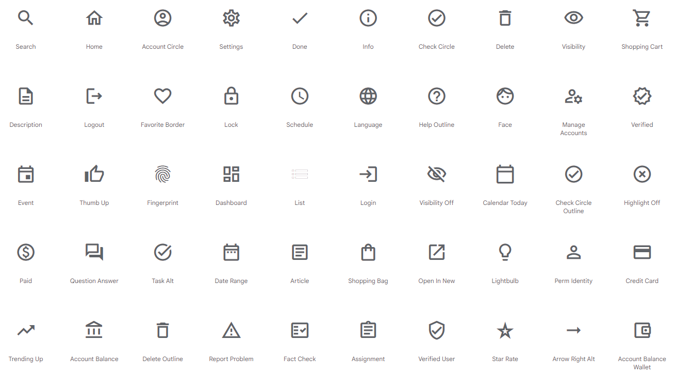
Icons

Slide 11
Footer
The footer of the website contains contact information such us: phone number, email address, year the website created with allowed note of a Copyright and social media links and is visually separated from the rest of the website.
The color background for the footer is: #4CB5F7 with no buttons on it. The footer is full width of the website. The height of the footer should be visually harmonical with the rest of the site.
The font used for the footer text is Paragraph with its color #245675.
An example of the footer design is shown below:
Phone number: 843-338-5171, Email:RockNRome21@Gmail.com
Created in 2023. All rights reserved.

Slide 12
Margins and Padding
Below is an example of a settings for Margins, Borders and Padding used on the website. Both Margin and Border are set to 20px. The Padding may vary, depending on a design of a specific element and may vary, but to be no less than 20px as well
Margin 20px
Border 20px
Padding (varies, 20px minimum)
Content

